Slide 1
Topic: Statistics
EQ: How can we use measures of center and spread to compare data sets?

Slide 2
Topic: Statistics
EQ: How can we use measures of center and spread to compare data sets?
Starter – Daily 5
1. Define median.
2. What is the most commonly used measure of center?
3. Write the formula for finding the shorter side of a right angled triangle
4. Which of the two has gaps in between the columns: bar graph or histogram?
5. Arrange the following data set into a stem and leaf plot: 3, 11, 14, 21

Slide 3
Class Activity
15 of you have been given Post-It notes.
Write the number of hours you spent on your phone yesterday
2) Stick your Post-It note on the dot plot line on the board above the corresponding number
3) Working in pairs, find the mean, median, mode and range of the data set.
Notes:
Draw a dot plot line on the board with the numbers 0-10
Hand out post-it note to 15 members of the class, using your discretion

Slide 4
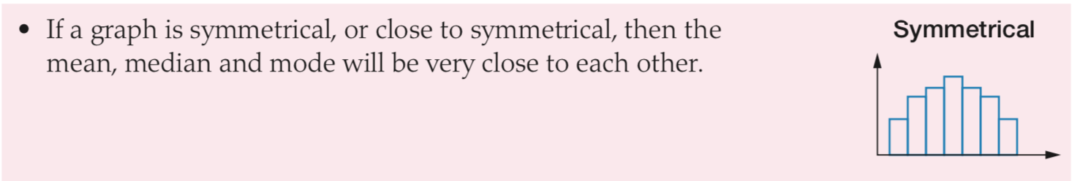
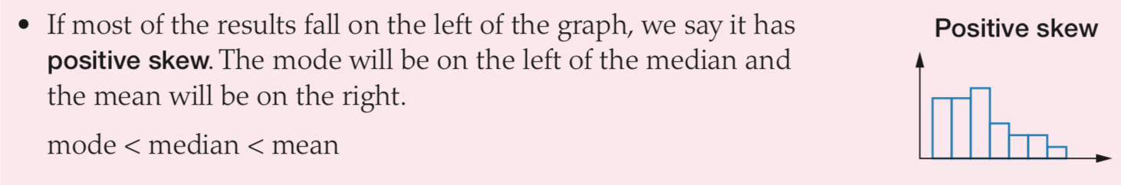
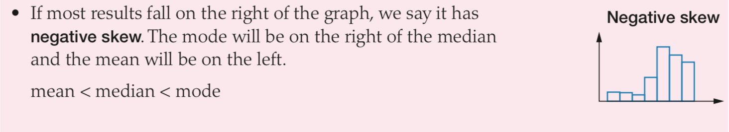
Topic: Statistics
EQ: How can we use measures of center and spread to compare data sets?
Symmetry and skew: We need to be able to describe what we see in a statistical graph. A symmetrical graph has frequencies that are evenly distributed about the median. A skewed graph has higher frequencies on either side of the median.

Slide 5

Practice
Match the Distributions Worksheet
Notes:
Independent practice

Slide 6
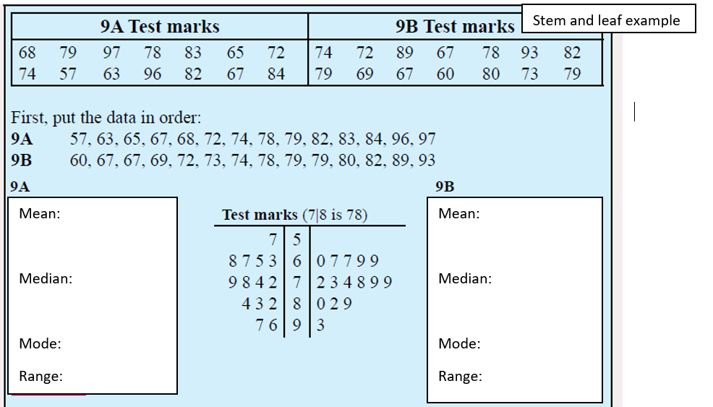
Topic: Statistics
EQ: How can we use measures of center and spread to compare data sets?
Why do we compare data?
We can use different data representations (i.e. back to back stem and leaf plots or histograms) to compare two different sets of data about the same topic.
Comparisons need to include: - data representation - Analysis (mean, median, mode, range, etc…) - conclusion paragraph
Stem and leaf example:
We are comparing test data from two different classes. We want to find out which class did better.
Start calculating mean median and mode!
Notes:
- Hand out this example to students (included in resources)

Slide 7

76.07
76
No mode
40
75.86
76
67, 69, 79
33
positive
means
medians

Slide 8
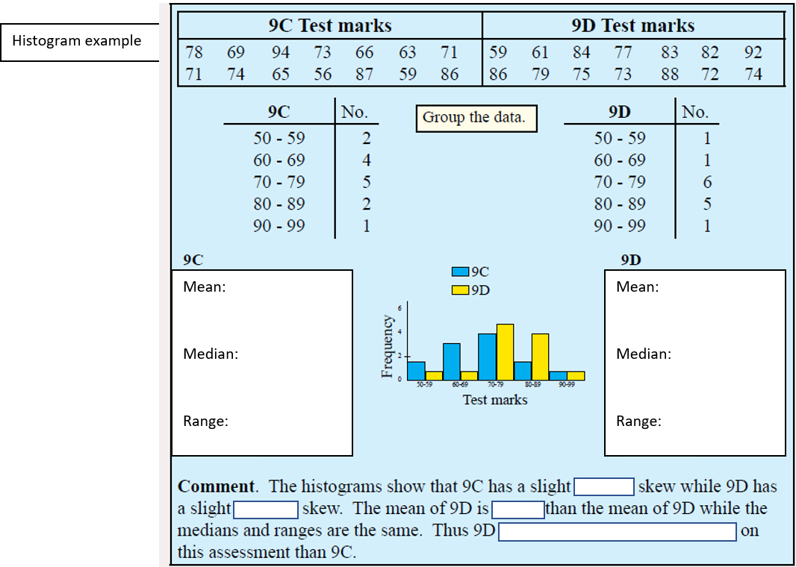
Again…..We are comparing test data from two different classes. We want to find out which class did better.
Start calculating mean median and range!
72.29
74.9
40
75.86
74.9
40
positive
negative
higher
has a slightly better performance

Slide 9
Practice
Comparing Data Sets Worksheet
Notes:
Independent practice

Slide 10
Homework
Statistics Foldable
- Do everything EXCEPT Box Plot and Upper and Lower Quartile
Notes:
Independent practice

Slide 11
Remember…
Write a summary answering the essential question.
Review Notes

